Slide 1
Discrete Maths
1.3. Predicate Logic
Objective
to introduce predicate logic (also called the predicate calculus)
Notes:
a predicate is commonly understood to be a Boolean-valued function P: X→ {true, false}, called the predicate on X.

Slide 2
Overview
Motivation
Predicate Logic
Quantifiers
From English to Logic
Domain Affects Translation
Translation Examples
More Information

Slide 3
1. Motivation
Two sentences:
“All men are mortal.”
“Socrates is a man.”
Is Socrates mortal?
These sentences and question cannot be represented in propositional logic.
We need a logic that talks about objects (things), their properties, and their relations.
Notes:
Mortal means subject to death
Socrates was an ancient Greek philosopher who is widely credited for laying the foundation for Western philosophy.-

Slide 4
2. Predicate Logic
Based on prop. logic. The new features:
Variables: x, y, z
Predicates: P(x), M(x, y), etc.
a bit like functions
Two quantifiers (∀, ∃ to be covered in a few slides)
Predicates can be used to represent properties and relations.

Slide 5
A Predicate as a Property
Let P(x) mean “x > 0” for integers. Then:
P(-3) is false P(0) is false
P(3) is true P(5) is true

Slide 6
A Predicate as a Relation
Let “x + y = z” be R(x, y, z) and U be the integers:
R(2,-1,5) is false
R(3,4,7) is true
R(x, 3, z) invalid (no unbound variables allowed)
Let “x - y = z” be Q(x, y, z), with U as the integers:
Q(2,-1,3) is true
Q(3,4,7) is false
Q(x, 3, z) invalid

Slide 7
Question
Consider the proposition function Q(x,y,z) defined by:
X+y=z
What is the truth value of Q(2,3,5)?
What is the truth value of Q(0,1,2)?

Slide 8
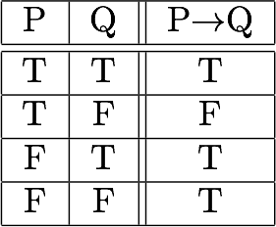
Compound Expressions
All the operators from prop logic can be used in predicate logic (i.e. ¬, ∨, ∧, →)
e.g. let P(x) be “x > 0” Then:
P(3) ∨ P(-1) is true
P(3) ∧ P(-1) is false
P(3) → P(1) is true
P(3) → P(-1) is false
Invalid, since unbound variables are not allowed:
P(3) ∧ P(y)
P(x) → P(y)

Slide 9
3. Quantifiers
We use quantifiers to 'bind' variables in expressions:
Two quantifiers:
Universal Quantifier, “For all,” symbol: ∀
English: every, all
Existential Quantifier, “There exists,” symbol: ∃
English: some, at least one
continued

Slide 10
3.1. Universal Quantifier
∀x P(x) is read as “For all x, P(x)” or “For every x, P(x)”
Examples:
If P(x) means “x > 0” and U is the integers, then ∀x P(x) is false
If P(x) means “x > 0” and U+ is the positive integers, then ∀x P(x) is true
If P(x) means “x is even” and U is the integers, then ∀x P(x) is false
P(x) means “x > 0” and U+ is the positive integers, then ∀x P(x) is true
Notes:
Integer :one of the positive or negative numbers 1, 2, 3, etc., or zero.

Slide 11
3.2. Existential Quantifier
∃x P(x) is read as “For some x, P(x)”, or “There is an x such that P(x),” or “For at least one x, P(x).”
Examples:
If P(x) means “x > 0” and U is the integers, then ∃x P(x) is true.
If P(x) means “x < 0” and U + is the positive integers, then ∃x P(x) is false
If P(x) means “x is even” and U is the integers, then ∃x P(x) is true.
Notes:
X>0={1,2,3,4,5…..}
X<0={-1,-2,-3,-4,-5…..}
X= even={……………-4,-2,0,2,4,6,8,……..}

Slide 12
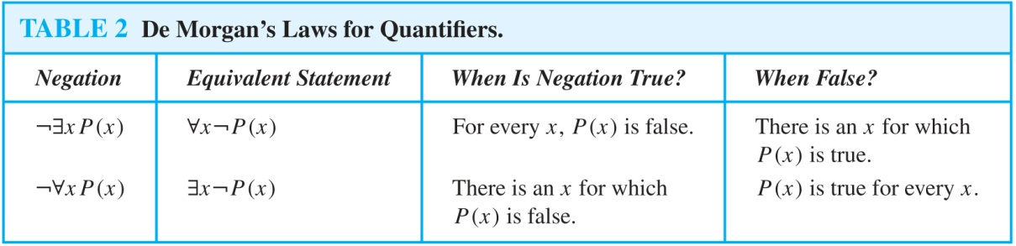
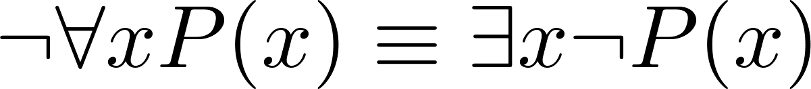
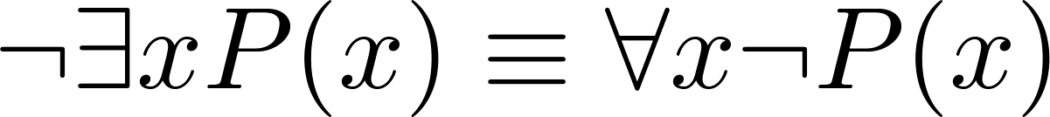
3.3. De Morgan’s Laws for Quantifiers
The rules for negating quantifiers are:
The table shows that:

Slide 13
Basic concept
All S(x) is P(x)
∀ x ( S(x) → P(x) )
No S(x) is P(x)
∀ x( S(x) → ¬P(x) )
Some S(x) is P(x)
∃ x (S(x) ∧ P(x) )
• Some S(x) is not P(x)
∃ x (S(x) ∧ ¬P(x))

Slide 14
4. From English to Logic
The translation of English to predicate logic is difficult because we now have quantifiers (∀ and ∃).
There are special translations for sentences using:
all-are
all-and-are
some-are
no-are
some-are-not
not-all-are
all-are-not
only-are
these two are the
most important
to memorize
variations
of 4.3
variations
of 4.1

Slide 15
4.1. All-are: All p's are q's
Memorize this one
All ≡ ∀ ; are ≡ →
"All ps are q's" becomes ∀x (p(x) → q(x))
e.g. "All students are hard-working" becomes ∀x (s(x) → hw(x))
The common mistake is to translate all-are into ∀ and ∧
"All ps are q's" is NOT ∀x (p(x) ∧ q(x))
Logically this is "too strong"
✓
✓
✗

Slide 16
4.2. All-and-are
"All men and women are human" becomes
∀x ( m(x) ∨ w(x) → h(x))
Why not translate to:
∀x ( m(x) ∧ w(x) → h(x))
The ∧ is "too strong"
✓
✗

Slide 17
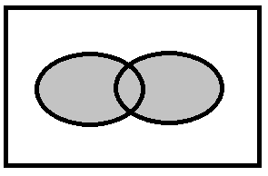
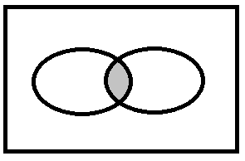
Why "too strong"?
Consider the meaning of m(x) ∨ w(x) and m(x) ∧ w(x)
m
w
m
w
✓
✗
∨
∧
All men and women are ...
These are people who are both men
and women, which is too small a group.

Slide 18
4.3. Some-are: Some p's are q's
Memorize this one
Some ≡ ∃ ; are ≡ ∧
"Some ps are q's" becomes ∃x (p(x) ∧ q(x))
e.g. "Some women are tall" becomes ∃x (w(x) ∧ t(x))
Why not: ∃x (w(x) → t(x))
Logically this is "too weak"
✓
✓
✗

Slide 19
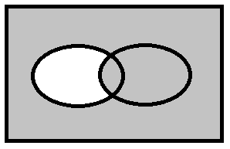
Why too weak?
U
t
U
w
t
w
✓
✗
∃x (w(x) ∧ t(x))
∃x (w(x) → t(x))
Some women are tall
The ∃ and → is too weak since it allows a non-women to be tall which does not 'fit' the English meaning.

Slide 20
4.4. No-are: No p's are q's
"No" = 0 = not (1 or more) = ¬ ∃x
"No p's are q's" becomes ≡ ∀x ¬ (p(x) ∧ q(x)) ≡ ∀x (¬p(x) ∨ ¬q(x)) ≡ ∀x (p(x) → ¬q(x))
✓

Slide 21
4.5 Some-are-not
Some p's are not q's
becomes ∃x (p(x) ∧ ¬q(x))
4.3 translation + an
inner not

Slide 22
4.6. Not-all-are
Not all p's are q's
becomes ¬∀x (p(x) → q(x)) ≡ ∃x ¬ (¬p(x) ∨ q(x)) ≡ ∃x (p(x) ∧ ¬q(x)) ≡ "Some p's are not q's"
4.1 translation + an
outer not
same as 4.5!

Slide 23
4.7. All-not
4.1 translation + an inner not
All p's are not q's
becomes ∀x (p(x) → ¬q(x))
This is the same as 4.4. "No p's are q's"
Notes:
All not means all are not

Slide 24
4.8. Only-are
U
p
q
"Only p's are q's" can be drawn as "subset":
Another way of saying this is "All q's are p's" which becomes: ∀x (q(x) → p(x))
The diagram for this is not the same shape as the one above because it also includes p's which are not q's:
p
U
q

Slide 25
5. Domain Affects Translation
“Every student in this class knows Java.”
Decide on the domain U.
Solution 1: If U is all students in this class, let J(x) be “x knows Java”. Translate as ∀x J(x)
Solution 2: If U is all people, let S(x) be “x is a student in this class”. Translate as ∀x (S(x)→ J(x))
J
U is
'class students'
This one is better
since U is more general.
s
j
U is 'all people'

Slide 26
6. Translation Examples
“Some student in this class has visited Mexico.”
Solution: Let M(x) be “x has visited Mexico” and S(x) be “x is a student in this class,” and U be all people.
∃x (S(x) ∧ M(x))
“Every student in this class has visited Canada or Mexico.”
Solution: Let C(x) be “x has visited Canada.”
∀x (S(x)→ (M(x) ∨ C(x)))
∃x (S(x) ∧ M(x))
Translation 4.3
Translation 4.1

Slide 27
Example
U = {green, red, blue}
G(x): x is a green
R(x): x is a red
B(x): x is a blue
Translate “Everything is a green”
Solution: ∀x G(x)
continued

Slide 28
U = {green, red, blue}
G(x): x is a green
R(x): x is a red
B(x): x is a blue
“Nothing is a red
Solution: ¬∃x R(x)
Nothing == zero ==
not (1 or more) == ¬∃x
continued

Slide 29
U = {green, red, blue}
G(x): x is a green
R(x): x is a red
B(x): x is a blue
“All Greens are Reds.
Solution: ∀x (G(x)→ R(x))
Translation 4.1
continued

Slide 30
U = {green, red, blue}
G(x): x is a green
R(x): x is a red
B(x): x is a blue
“Some Greens are Blue
Solution: ∃x (G(x) ∧ B(x))
Translation 4.3
continued

Slide 31
U = {green, red, blue}
G(x): x is a green
R(x): x is a red
B(x): x is a blue
“No Red is a Blue.”
Solution: ¬∃x (R(x) ∧ B(x))
Translation 4.4
continued

Slide 32
U = {green, red, blue}
G(x): x is a green
R(x): x is a red
B(x): x is a blue
“If any green is a red then it is also a blue”.
Solution: ∀x (∃(x)(G(x) ∧ R(x))→ B(x))
"any" suggests ∃ and ∧,
but since it is the condition
of if-then, just use ∧

Slide 33
All graduate students are smart.
∀ x Smart(x)
Someone of the students are smart
∃ x Smart(x)

Slide 34
Exercise
1. Let Q(x, y) denote the statement "x is greater than y." What are the truth values of the following?
Q (3, 1)
Q (5, 5)
Q (6, -6)
Q (2⁸, 256)
2. Let P(x) be the statement "x is happy," where the universe of discourse for x is the set of students. Express each of the following quantifications in English.
∃ x P(x)
∀ x ¬ P(x)
∃ x ¬ P(x)
¬ ∀ x ¬ P(x)
Notes:
There exist a student who is happy

Slide 35
Exercise
3. Let P(x) be the statement " x > x²." If the universe of discourse is the set of real numbers, what are the truth values of the following?
P(0)
P(1/2)
P(2)
P(-1)
∃ x P(x)
∀ x P(x)

Slide 36
Exercise answers
1. a) T b) F c) T d) F
2.
There is a student who is happy.
Every student is not happy.
There is a student who is not happy.
Not all students are unhappy.
3. a) F b) T c) F d)F e) T f) F

